Slide 1
Team 6 Final Product Demonstration Infection control system (hand-hygiene monitoring)
By Andris Vaivods, Joseph Nickson, Bradley Gichangi, Ioana-Cristina Igret, Chun Lim, Mark Vink, Yi Low
Date: 19th March, 2021
Notes:
We are Team 6 and this is our final product presentation for an Infection control system. In this presentation we will talk about our implementation and take you through the features of our project. But first we will introduce ourselves.

Slide 2
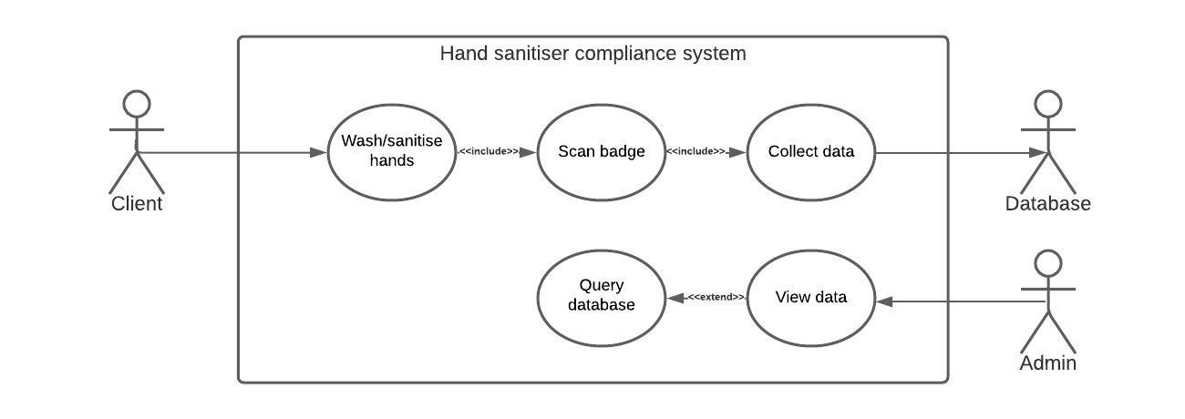
The Goal of the Project
To implement a hand hygiene monitoring system
Modernise old school tracking systems with pen and paper
Notes:
The Project's goal was to implement a hand hygiene monitoring system that could modernise old school tracking systems with pen and paper.
Our plan from the get-go was to have the client scan their RFID badge and store the data into a database hosted on a server. Then, give the admin the option to view the data in a visually pleasing way on our website, where we would query the data and generate graphs.

Slide 3




Software implementation
Database with MYSQL
Machine Learning with Python
Graph Generation with Python
Website (HTML, CSS, PHP)
Server graph generation with PHP
Agile Methodology using Jira
Notes:
To do this, we divided the Project into five large parts. The database, Machine Learning and Graphs implemented using Python. The Website and Server Graph Generation, that use HTML, CSS, JavaScript and PHP. To keep track of our tasks and issues, we used the Agile methodology and Jira. We will talk more about project management towards the end of the presentation.

Slide 4
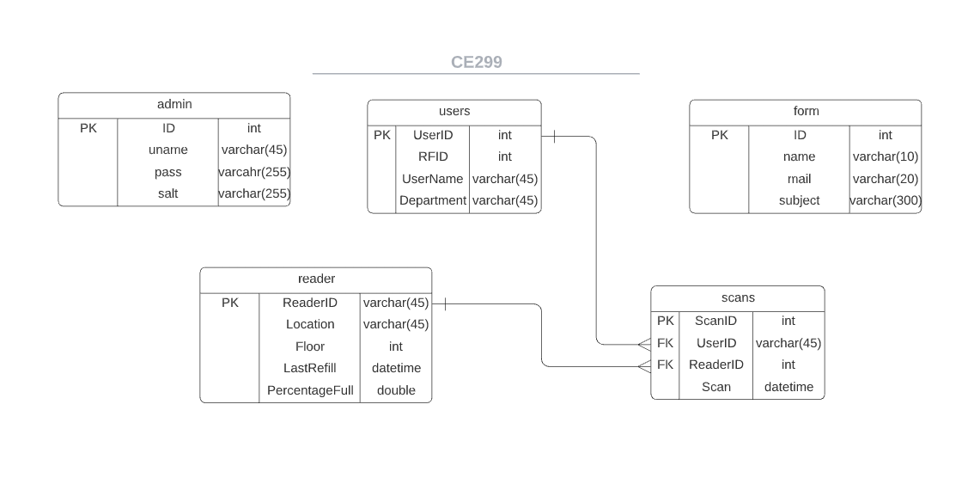
Database
Notes:
So firstly the database since it is the backbone of our website and graph generation. The database consists of 5 tables. The admin table that lets admins log into our website, the passwords are encrypted for safety using hashing. The form table that allows anyone using the website to submit a concern. The Users table, specifically their name, RFID tag and department. The reader's table or antibacterial dispensers, their location, floor when they were last refilled, and percentage full, as this would help monitor when they have to be refilled. Finally, Dispenser uses or scans, that include when and who used it. We thought this implementation would be useful as it has all the essential information for making a Hand Hygiene Monitoring System. Since it Is in Third Normal Form, it would also allow for easy additions in the future specific to the scenario. So, to sum up, when a User uses one of the readers, the result gets saved in the scans table. With the given information, we made visually appealing graphs and machine learning models that administrators could analyse through our website.

Slide 5
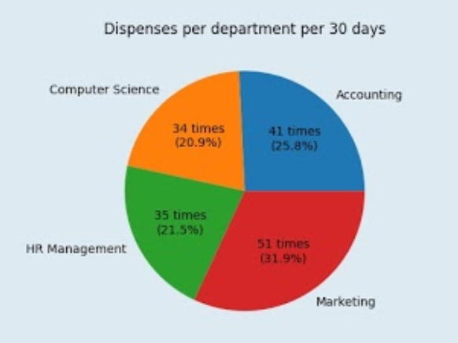
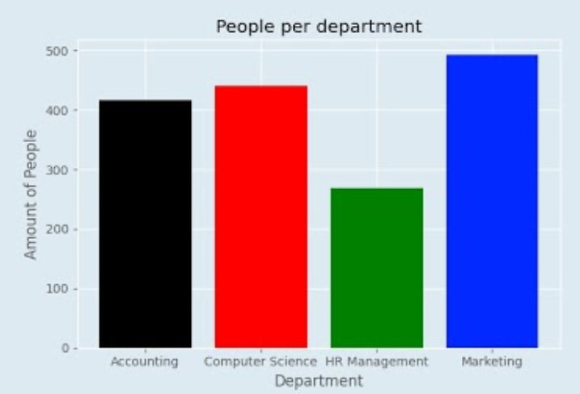
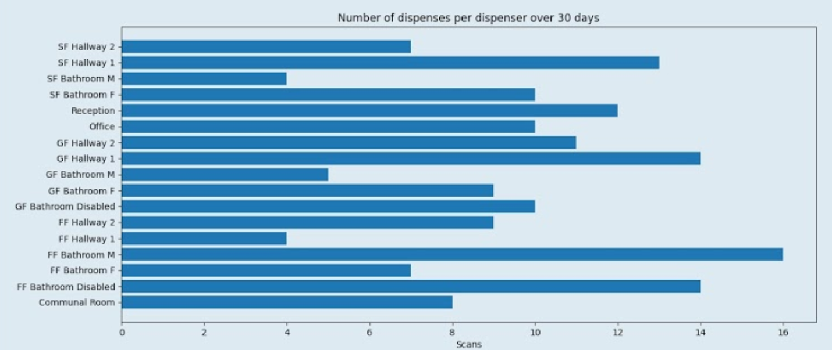
Python Graphs
Data
Departments
Scans
People
Dispensers
Time
Notes:
There are many ways to visualise the data that is stored within the database and using python we created a few graphs in 3 different formats, examples of some of them can be seen here.
Currently we have used 5 main data points for our graphs, and whilst they aren’t an exhaustive list of the data points that can retrieved from the data set, these are examples of what graphs can be created.

Slide 6
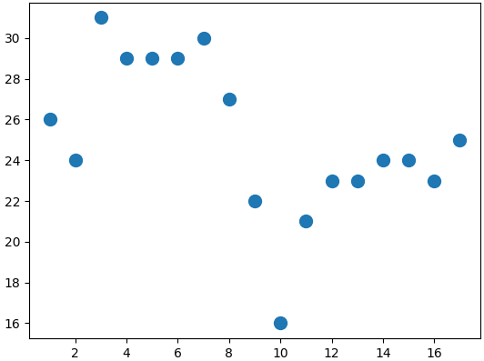
Machine Learning
The purpose of machine learning in our project is to identify any patterns in the data.
To display the clusters, we use a scatter diagram. However, looking at the data there is no clear trend/pattern so there is no information we can derive from the chart.
To solve this we use K-Means clustering algorithm.
Notes:
Machine learning is an important part in our project. It allows us to identify any patterns or trends in seemingly arbitrary data. Machine learning turns data into useful information.
To visualise the data, we use a scatter diagram. However, by looking at the scatter plots we can’t see any clear trends. This is an ideal instance to utilise K-Means clustering algorithm.

Slide 7
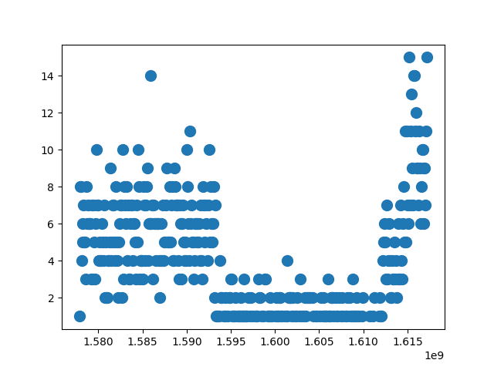
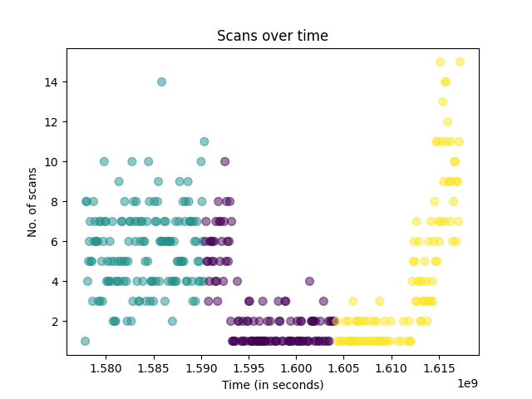
Displaying Clusters
Using K-Means clustering algorithm we are able to segment the data into subgroups that have similar behaviour.
These clusters are then colour coded to make it user friendly. It allows a clear visualisation of the different clusters of data.
Notes:
K-Means is a type of unsupervised learning algorithm that segments data that perform in a similar manner into subgroups. These groups are known as clusters.
When the number of clusters are inputted, the algorithm clusters the data accordingly. The clusters are then colour coded on the scatter diagram for ease of viewing.

Slide 8
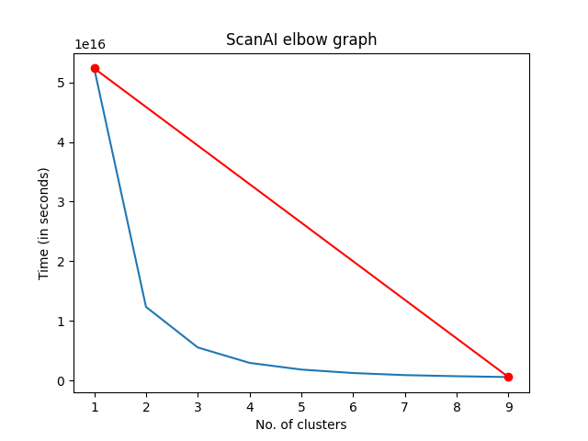
Choosing Number Of Clusters
The number of clusters (K value) is something that has to be designated however, this is a manual process.
To make this an automatic process there needs to be a system to calculate this number that is independent to the dataset. The elbow method is used for this purpose.
Notes:
The number of clusters is known as the K value. One of the problems we had to overcome with K-Means is that the K value has to be designated which is a manual process.
To combat this, we had to use a system that would automatically decide the K value regardless of the dataset. The solution of this is to use the elbow method. A line graph is drawn from the data and the elbow of the graph is the optimum K value.

Slide 9
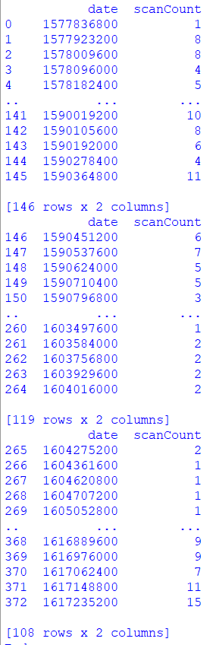
Clustered Data
The data for each point on the scatter diagram is outputted and sectioned by clusters.
Each data point is indexed and displayed as shown on the right.
Notes:
The data in the clusters is then outputted, with this data we can identify particular users in the clusters and perform actions to make any out of place data adhere to an expected standard.

Slide 10

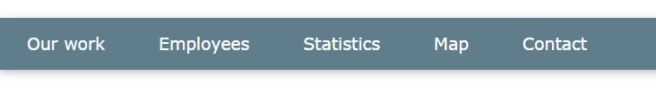
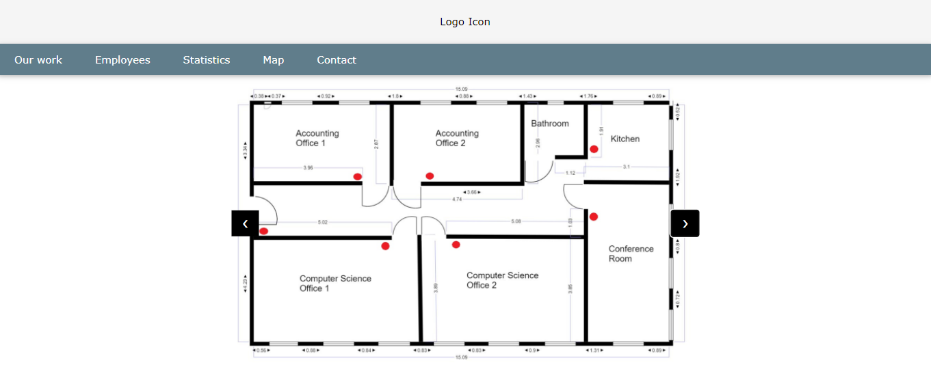
Website - Initial Design Plan
We made several changes to the initial design.
Now the website has 4 buttons in the navigation bar and a button titled Log In which gives access to the database for the administrator
Notes:
In the beginning the website was comprised of five pages: Our Work, Employees, Statistics, Map and Contact. Although we kept most of the pages as I planned them initially, there were also some changes made. For example, the Map page was supposed to display the plan of the building and each hand sanitizer in the building would have been shown onto the map so that the visitor can have a visual experience in order to understand better how these dispensers actually work on the ground. However, we decided that static pictures are too plain and therefore don’t add enough valuable information to our website, only clutter the navigation bar.

Slide 11
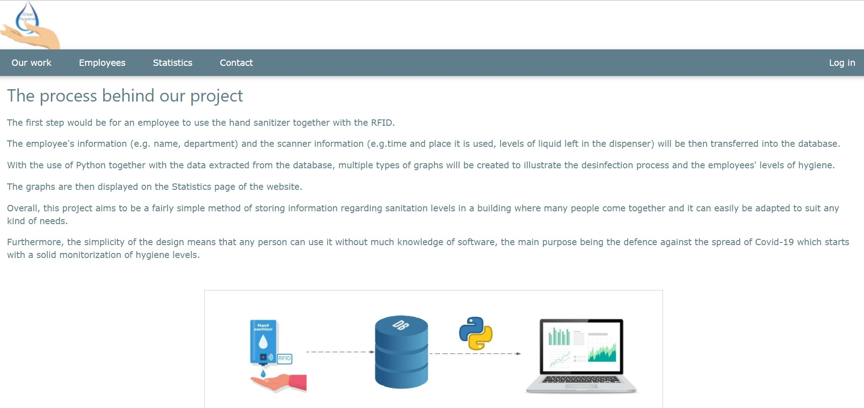
Final Design- Key Features
Index Page- Our Work
We decided it was better to remove the Map page.
A new feature is the Log In button, which gives the administrator access to the Admin page.
Notes:
I wanted the design to be calm and easy to work with, so I chose a classic navigation bar with a number of buttons, each displaying a different page. In this way, all the information is split and kept in one page with a suggestive title.
Our work page is where all the aspects of our project are briefly discussed, so that any visitor understands its components and its purpose

Slide 12
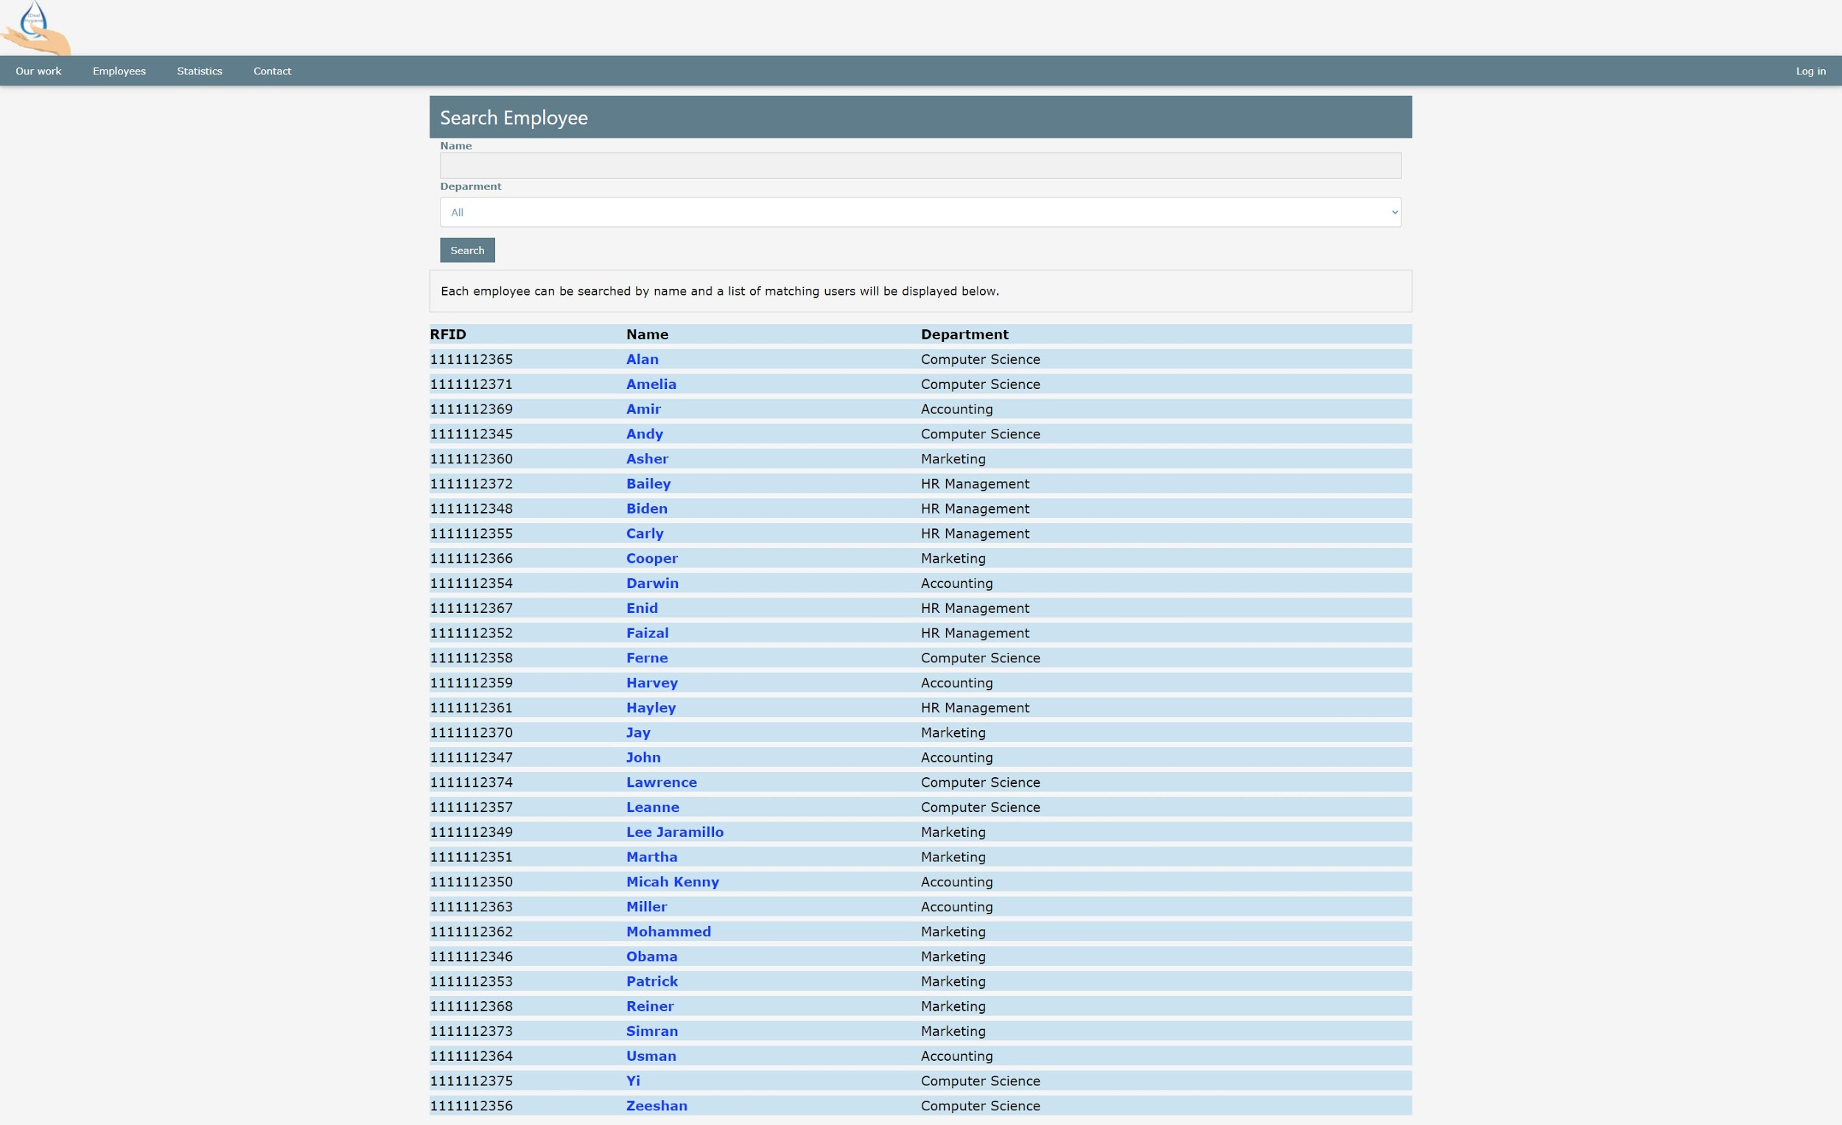
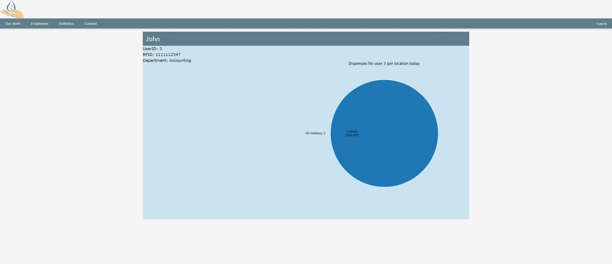
Final Design- Key Features
Employees Page
Profile of an employee searched by name in the search bar.
The profile shows the employee’s name, RFID and the department, alongside a graph showing the number of times and the place John has used the hand sanitiser that day.
Notes:
Employees page hosts a search bar and a filter for a quick overview of the company’s employees and a graph showing the number of times each of them used a hand sanitizer in a day.

Slide 13
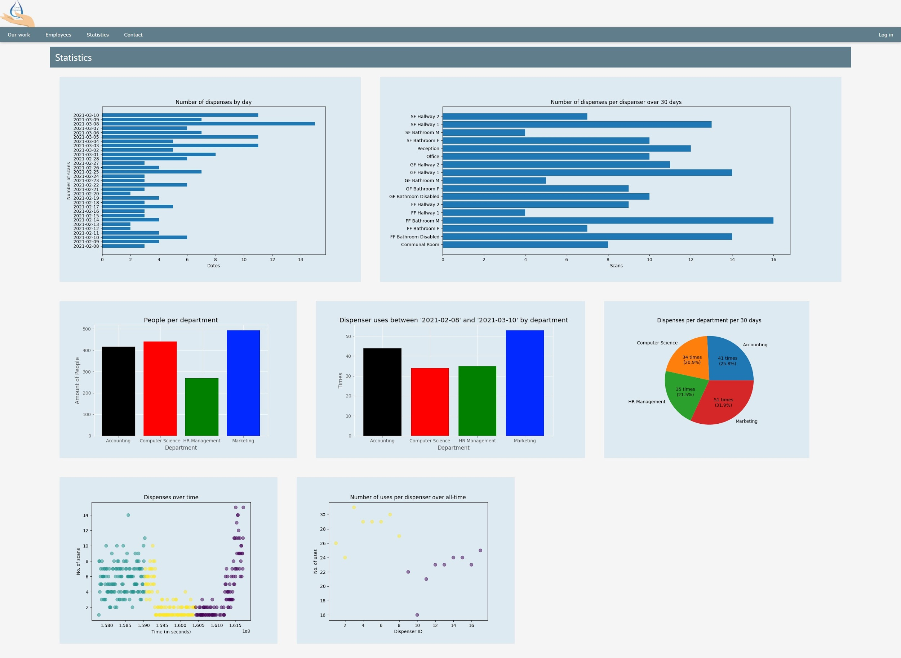
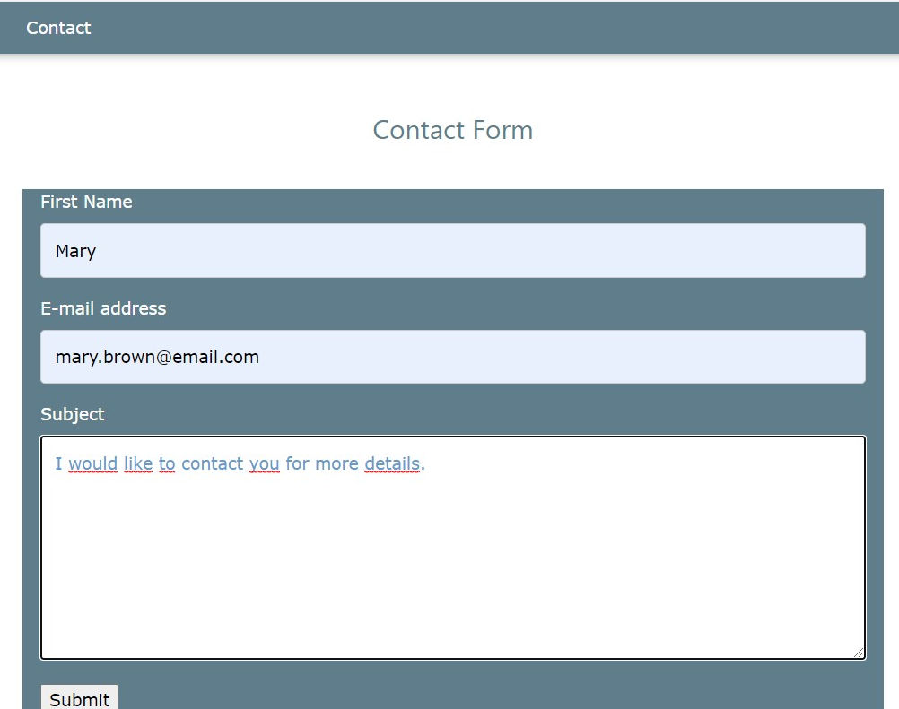
Final Design- Key features
Statistics Page
Contact Form
Notes:
Statistics is the page that displays the graphs which illustrate different data about the use of the hand sanitizers in the building.
Contact page is where any visitor can get in touch with the company for any kind of information by completing and sending a contact form.

Slide 14
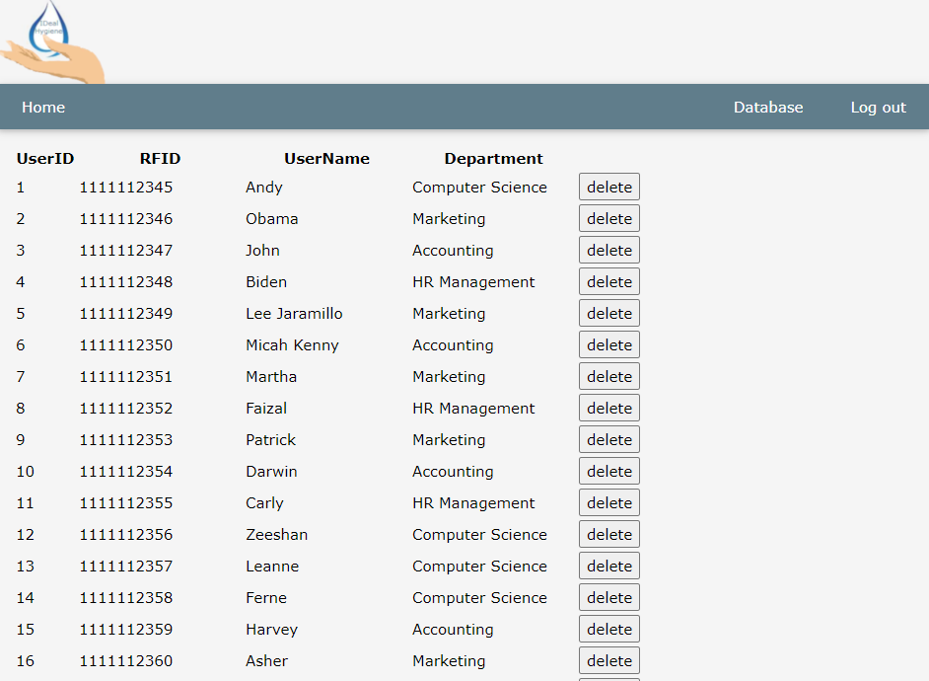
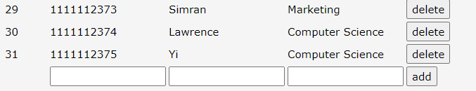
Admin Page
Named ‘Admin Page’ , it's actually function is to show the database’s Table via website.
Provide an easy way for user to check and do simple modification.
Notes:
This is the view of the Admin page, although it’s named as ‘admin page’, it actually provides a 0 IT knowledge way for the user to view the database.
It implements some basic function as add and deletes on it, even manual modification is usually not needed in our system, we still provide an alternative way for insurance.
Basically, the purpose of this page is to reduce the operation difficulty for our customers.

Slide 15
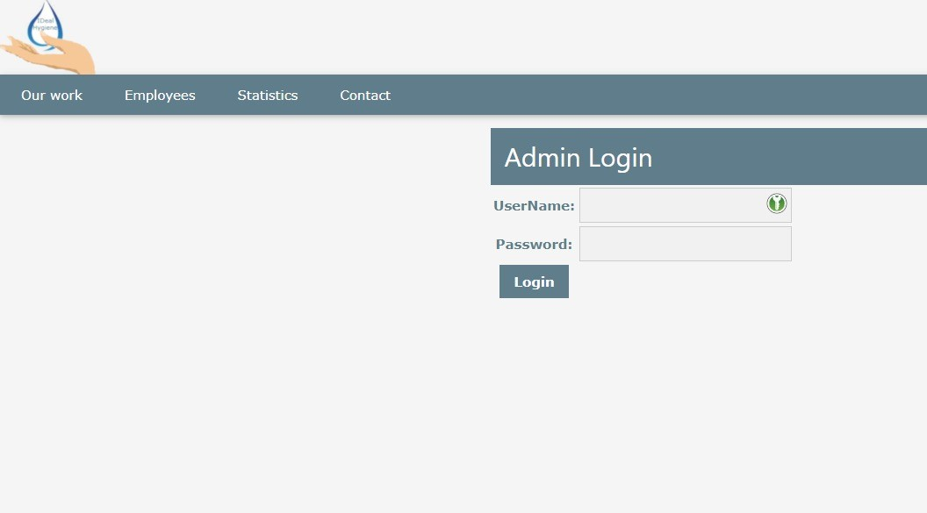
Login Page
A login system to secure database information from unauthorized access.
Use one of the latest and common hash method to protect admin’s information.
Notes:
A login system is one of the most basic ways to secure a website from unauthorized access. Information on our website is open to the public by default. We still implement a login page since it needs to limit that only ‘admin’ can modify the database from the website.
Therefore, We also implement SHA3_512 to protect our admin’s login information for more complete security.

Slide 16
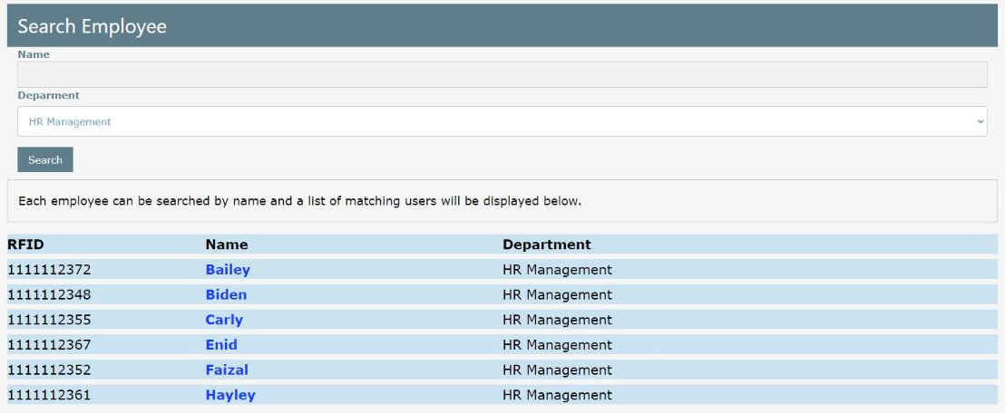
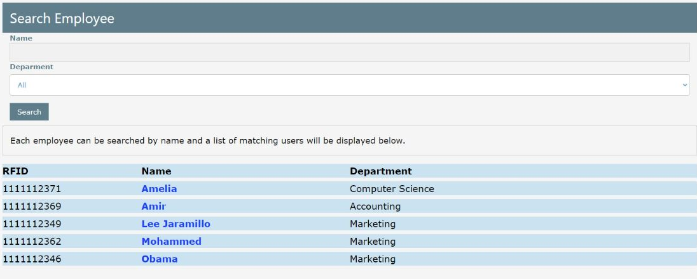
Website search
Results for filtering the users by department
Results for search “am”
Notes:
The page is provided with a list of all users in the database which it uses to generate an entry for every user matching the input search conditions. Which is blank on the initial page load so all users are generated.
Name search checks if any substring of the user name matches the search input.
Department filter checks if the user department matches the filtered department.

Slide 17
Server graph generation
Graphs are generated by the server helps avoid:
long load times,
vulnerability to denial-of-service attacks
Depending on the set update frequency for the graphs they could sometimes be out of date.
The website checks timestamps of the graph images to make sure it is always displaying the latest one.
The pages containing graphs are also refreshed every 60 seconds to make sure the user is seeing the most up to date graphs.
Notes:
New images are generated by the server based on the data about scans in the database using python scripts which in turn utilize Matplotlib to generate different graphs.
This is done so the website would not be vulnerable to denial-of-service attacks if malicious users were to be able to request the server to generate new images each time a user requested them. In addition to this, it is done so a user would have a nicer experience and not have to wait for the server to execute code before a page with graphs can be loaded.
This does come with a downside though which would be that depending on how often the server has been set up to regenerate the images their information could sometimes be out of date.
To avoid the browser caching images, the website checks timestamps of when the image was generated to ensure it is using the latest one available. Otherwise, an out of date image could be displayed.
The webpages that include graphs are set to refresh every 60 seconds to guarantee the user is looking at the latest version of the webpage.

Slide 18



Hosting on third-party Cloud
Unlimited Global Scale.
Having Closer Infrastructure to end user.
Highly Secure.
Fully Managed. (Manual Configuration, Power Supply, Internet Service Provider)
Notes:
Hosting is one of the most important parts of the Hand Hygiene Monitoring System. The reason why it’s important is related to the product requirement, which is the ability to serve as a 24/7 quick up-to-date system. There are several trustworthy hosting platforms, like Google Cloud, Amazon Web Service and Microsoft Azure. These platforms enable the system to have unlimited global scale. By that it means, we are able to scale up the system globally without any worry for hardware issue. The system will also have closer infrastructure to the end user, which really gives a huge boost to the system. Furthermore, the system can be more secure with the great security features provided by them. Our system can be fully managed by these platform and we are able to focus more on the system to provide the best available service from us.

Slide 19
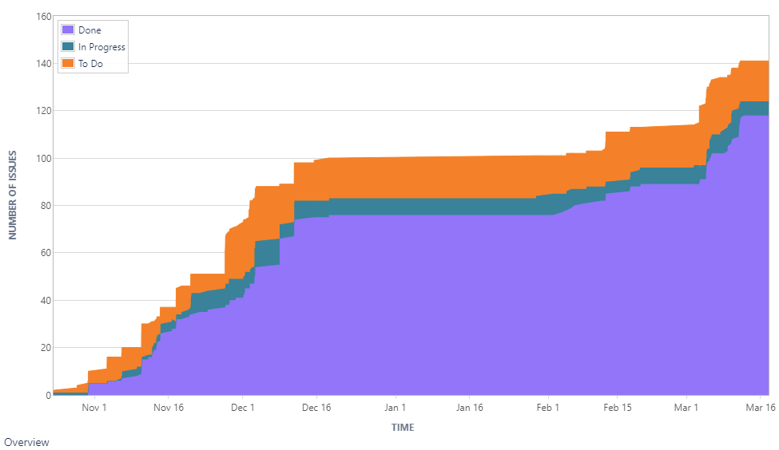
Project Management
Done the tasks that we set out to do, but…
Hindered communication, because of online meetings
Improvements in Jira usage
More time in meetings than we otherwise could have had, because of more free time
Online communication skills will come in handy in the future
Notes:
We are confident that we did not work up to our full potential concerning Project Management and that some mistakes and errors were in our control and slowed our progress. Such as the forgetfulness to update Jira. Our communication was hindered by only being online through Zoom. If we had the opportunity to get to know each other more by communicating in person, we would have had less trouble with people not showing up to meetings or updating Jira. On the bright side, the skills we have gained through only online communication will come in handy in future job prospects. As well as, online meetings allowed us to have more extended conversations about the project that otherwise we could have had since now most students have more free time.
And as you can see I the Cumulative flow diagram, by not updating Jira in the Winter break, it looks like we didn’t make any progress, but I can assure you that we did.

Slide 20
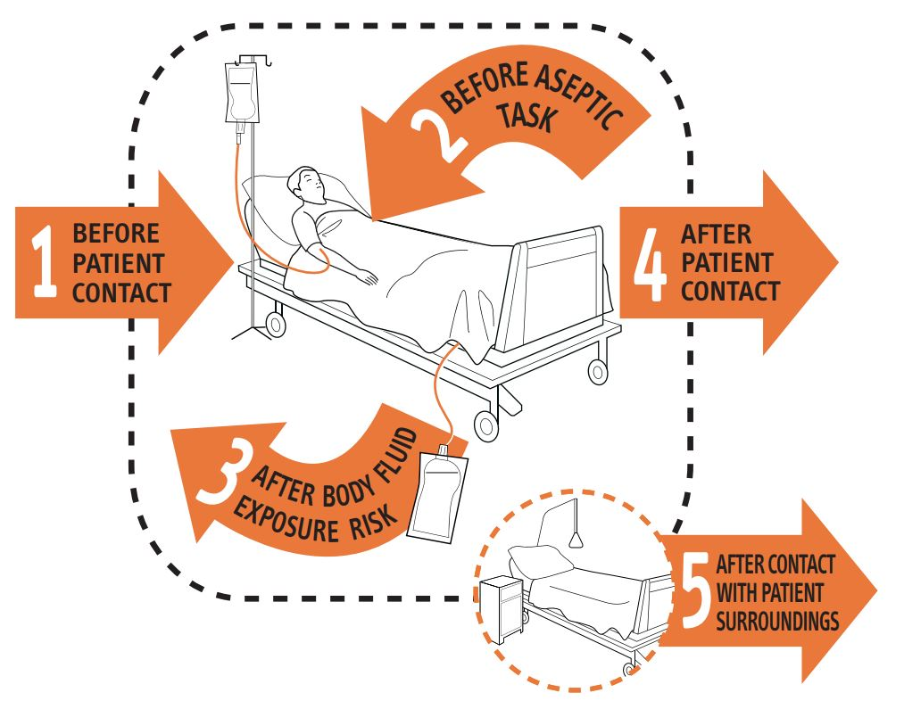
Future Improvements
Hosting the Database on a Server
Hardware implementation
Improved Map page to show the level of liquid left in each hand sanitizer and Heatmap
Individual hand hygiene opportunities and location tracking using machine vision utilizing cameras and RFID readers based on the 5 moments for hand hygiene described by the WHO.
Implement hand hygiene compliance score and more in depth individual performance tracking utilizing
information about hand hygiene
opportunities.
Notes:
To close out our presentation, here are a few things that we didn’t manage to do in our Final Product but would be a great addition in the future.
We wanted to host the database on a server, but since most good hosting services cost money in the end we hosted in locally.
Also, the disadvantage of working remotely caused problems in implementing :))the Hardware part. For this we would need an RFID reader, Python capable hardware like a Raspberry Pi or Arduino and Wi-Fi capability such as the one included in the Raspberry Pi 3.
Individual hand hygiene opportunities and location tracking using machine vision utilizing cameras, AI and additional RFID readers. This system would be used in accordance with the 5 moments for hand hygiene described by the WHO.
These systems would let us collect enough data that we would be able to calculate an accurate hand hygiene compliance score that we could give out per zone and even per individual more accurately. Once provided the hand hygiene score a heat map of the building can be provided where different hygiene levels can more easily be displayed and viewed.

Slide 21

Thank you for listening!

